Slide 1
World Refugee Forecast
Nathaniel Arnold | Ashley Overman | Basheer Eljabaly | Rishi Khanna

Slide 2
Purpose
Initial intent: overlay war/conflict, natural disasters, persecution
Due to time constrains: famine
Why do people seek refuge in other countries?
Forecast regions/countries that may experience a large influx of refugees

Slide 3
Goals accomplished
Analyze refugee data (statistics and distribution) to correlate
Divergence of mean
Poisson distribution
Select a sample of countries (because there are many in the data set we’ve been working with) in specific to analyze
Further analysis to determine a major factor (food deficit) – in progress

Slide 4
Data sets
Primary data set analyzed: Asylum Seekers (Monthly) from the UN Refugee Agency
Discrepancy/human error possibility – given values only account for refugee numbers reported
Doesn’t take into account illegal immigrants/refugees
Other data sets used: Food Deficit, GDP per capita (US$), Imports and Exports, Asylum Seekers, Happiness Index
Majority from the World Bank
Didn’t fully develop models for all of these (ran out of time)

Slide 5
Refugee Data: Initial Impressions
Initial findings in annual data show that most refugees come from Middle Eastern countries
Countries with the highest asylum seeking population were also in the Middle East and adjacent to countries that have high refugee populations
Hypothesis: Most refugees fled to adjacent/neighboring countries
Analysis on previous slide (just through top 5 in terms of refugee population) don’t show this.
Most refugees flee to countries that are further away from their home country
Top countries from both data sets (Afghanistan and Syria) analyzed to validate analysis
Follow up: Overriding factor that will drive people to certain countries over others (language barriers, cultural/racial differences, etc. in favor of something else)

Slide 6
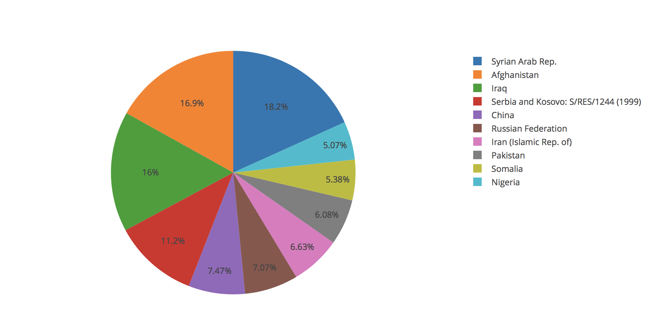
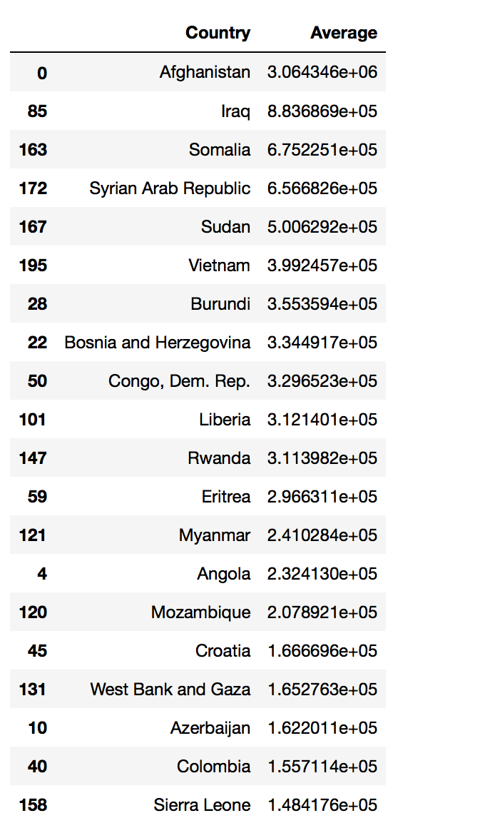
Top 10 Countries of Asylum by Year
(World Bank Dataset)
Top 10 Countries of Asylum by Month
(United Nations Dataset)

Slide 7
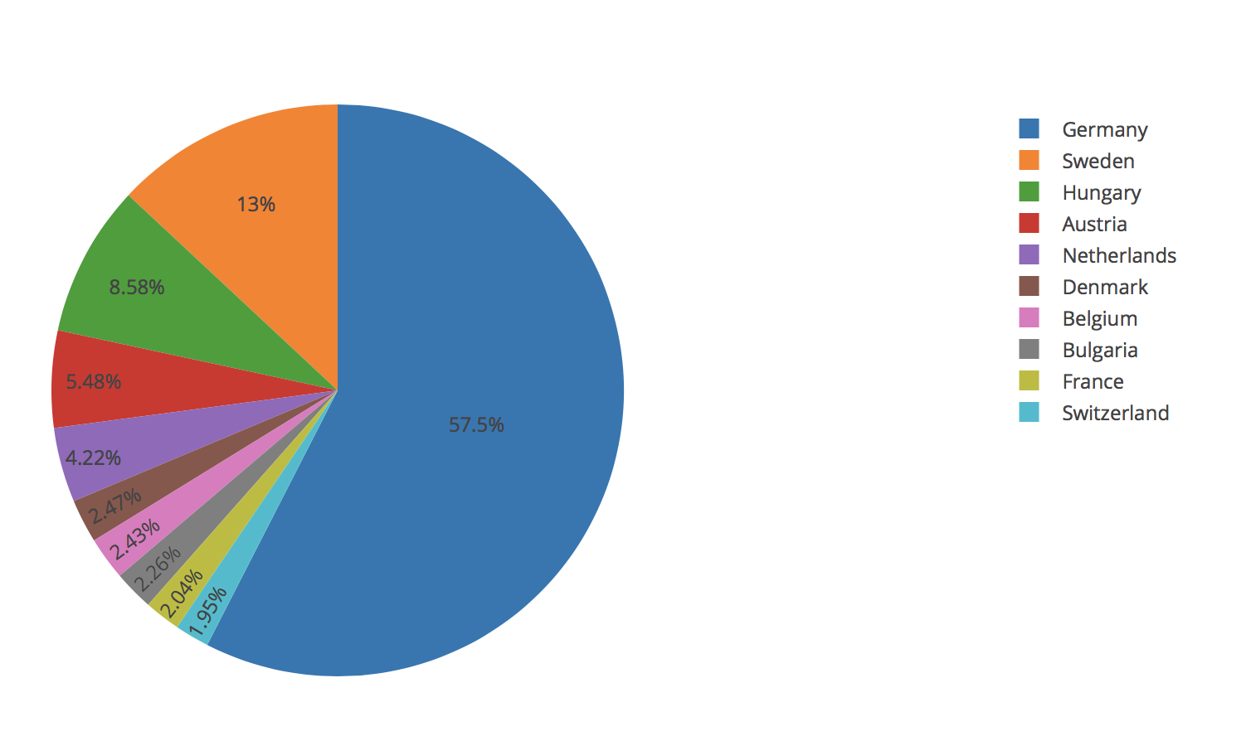
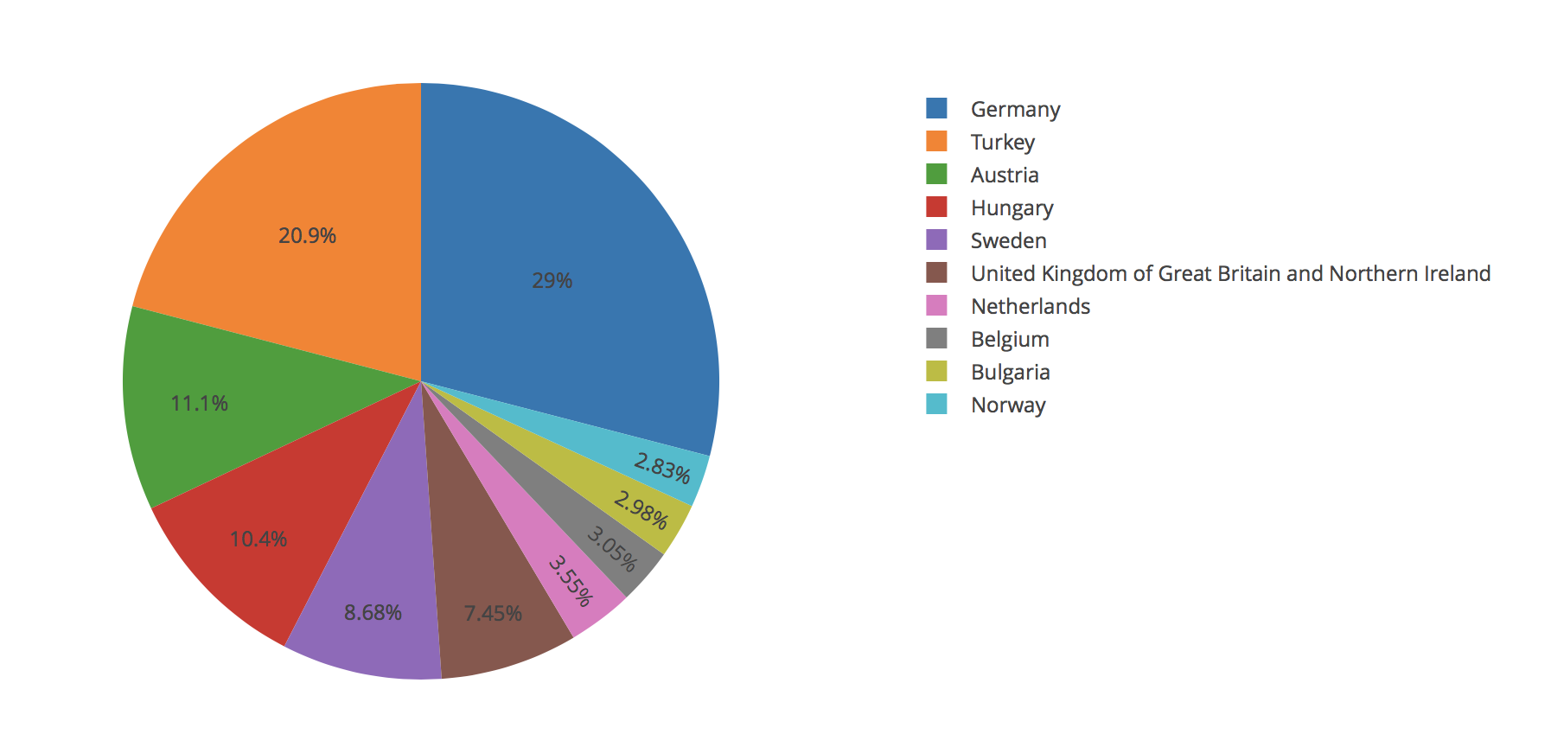
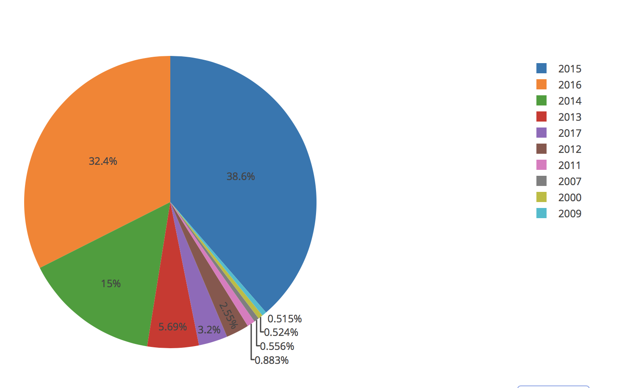
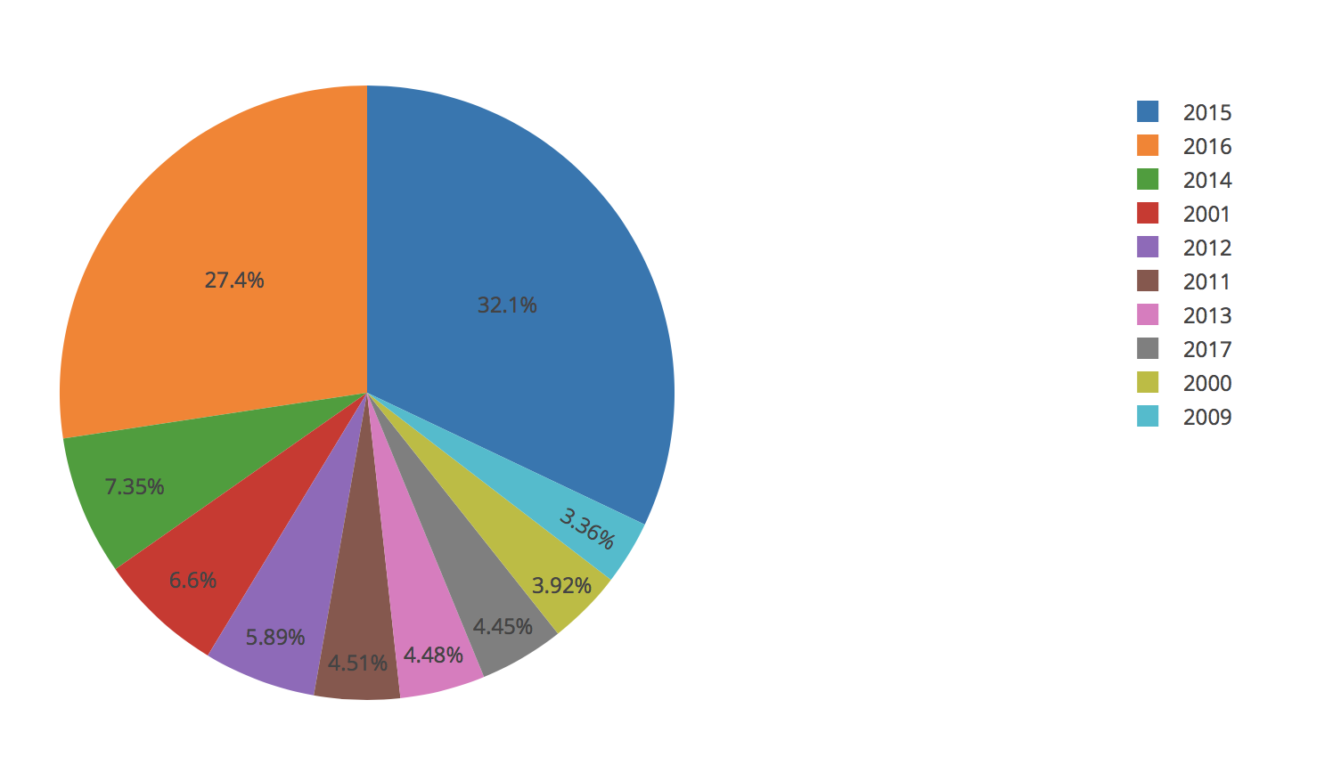
Afghanistan – Top 10 Countries of Asylum and Top 10 Years of Emigration
Syria – Top 10 Countries of Asylum and Top 10 Years of Emigration

Slide 8
Divergence of mean
Best displayed with density plots and indicator lines for mean, median and standard deviation
In almost all countries chosen, the mean is greater than the median
Indicates right skewed data
Outliers to the right of the data

Slide 9
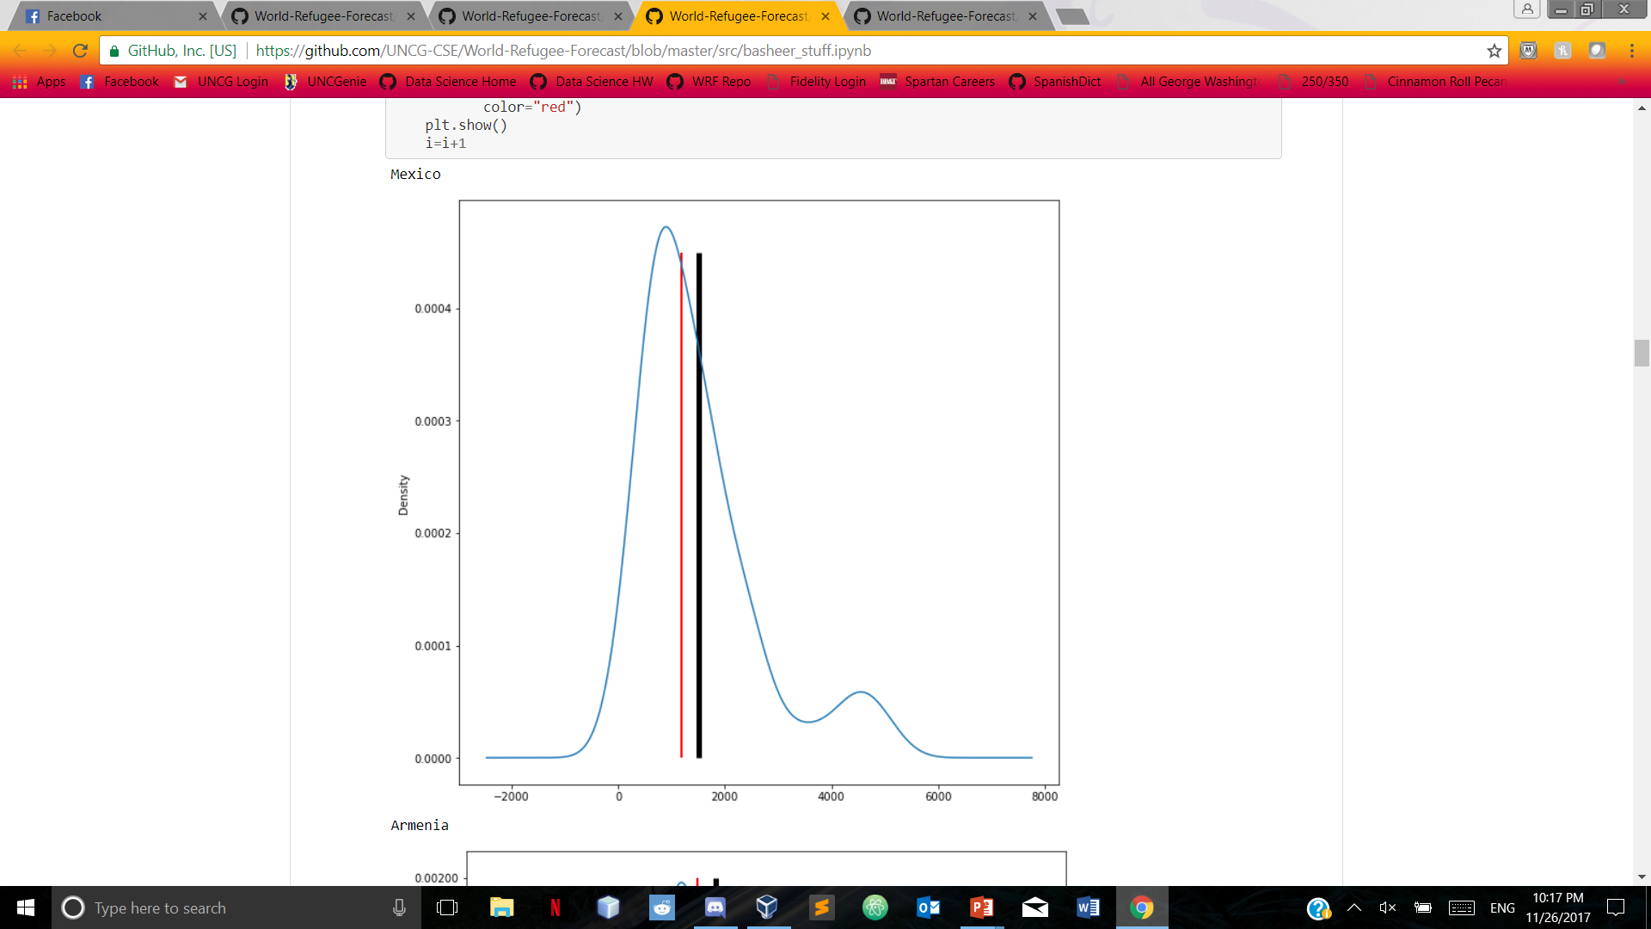
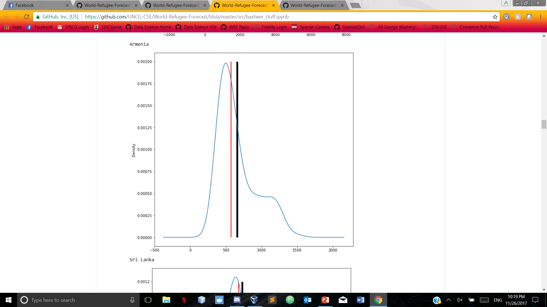
Divergence of Mean Mexico Armenia
Black line indicates mean, red line indicates median

Slide 10
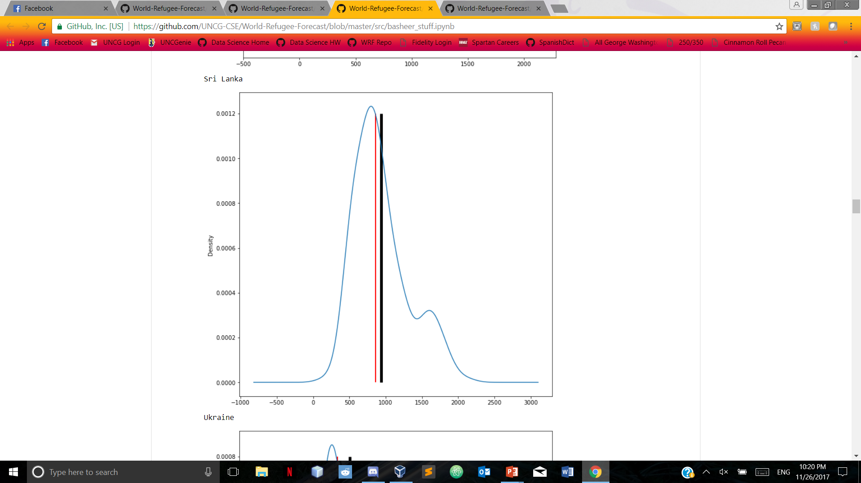
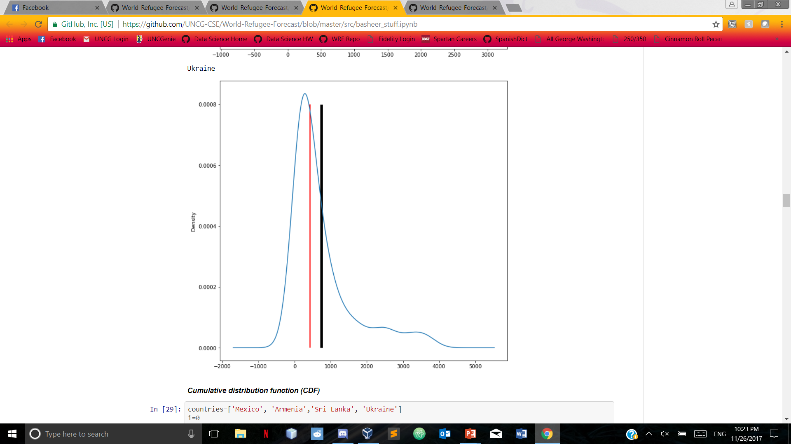
Divergence of Mean Sri lanka ukraine
Black line indicates mean, red line indicates median

Slide 11
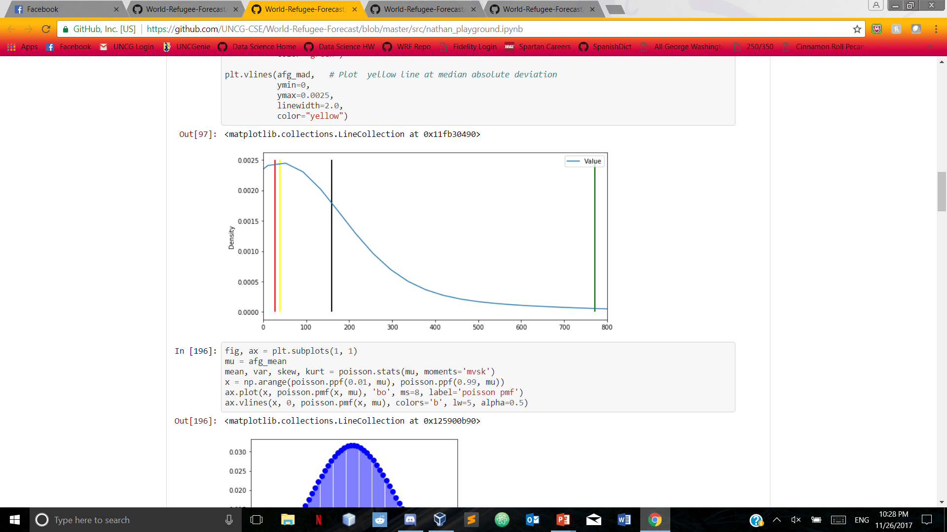
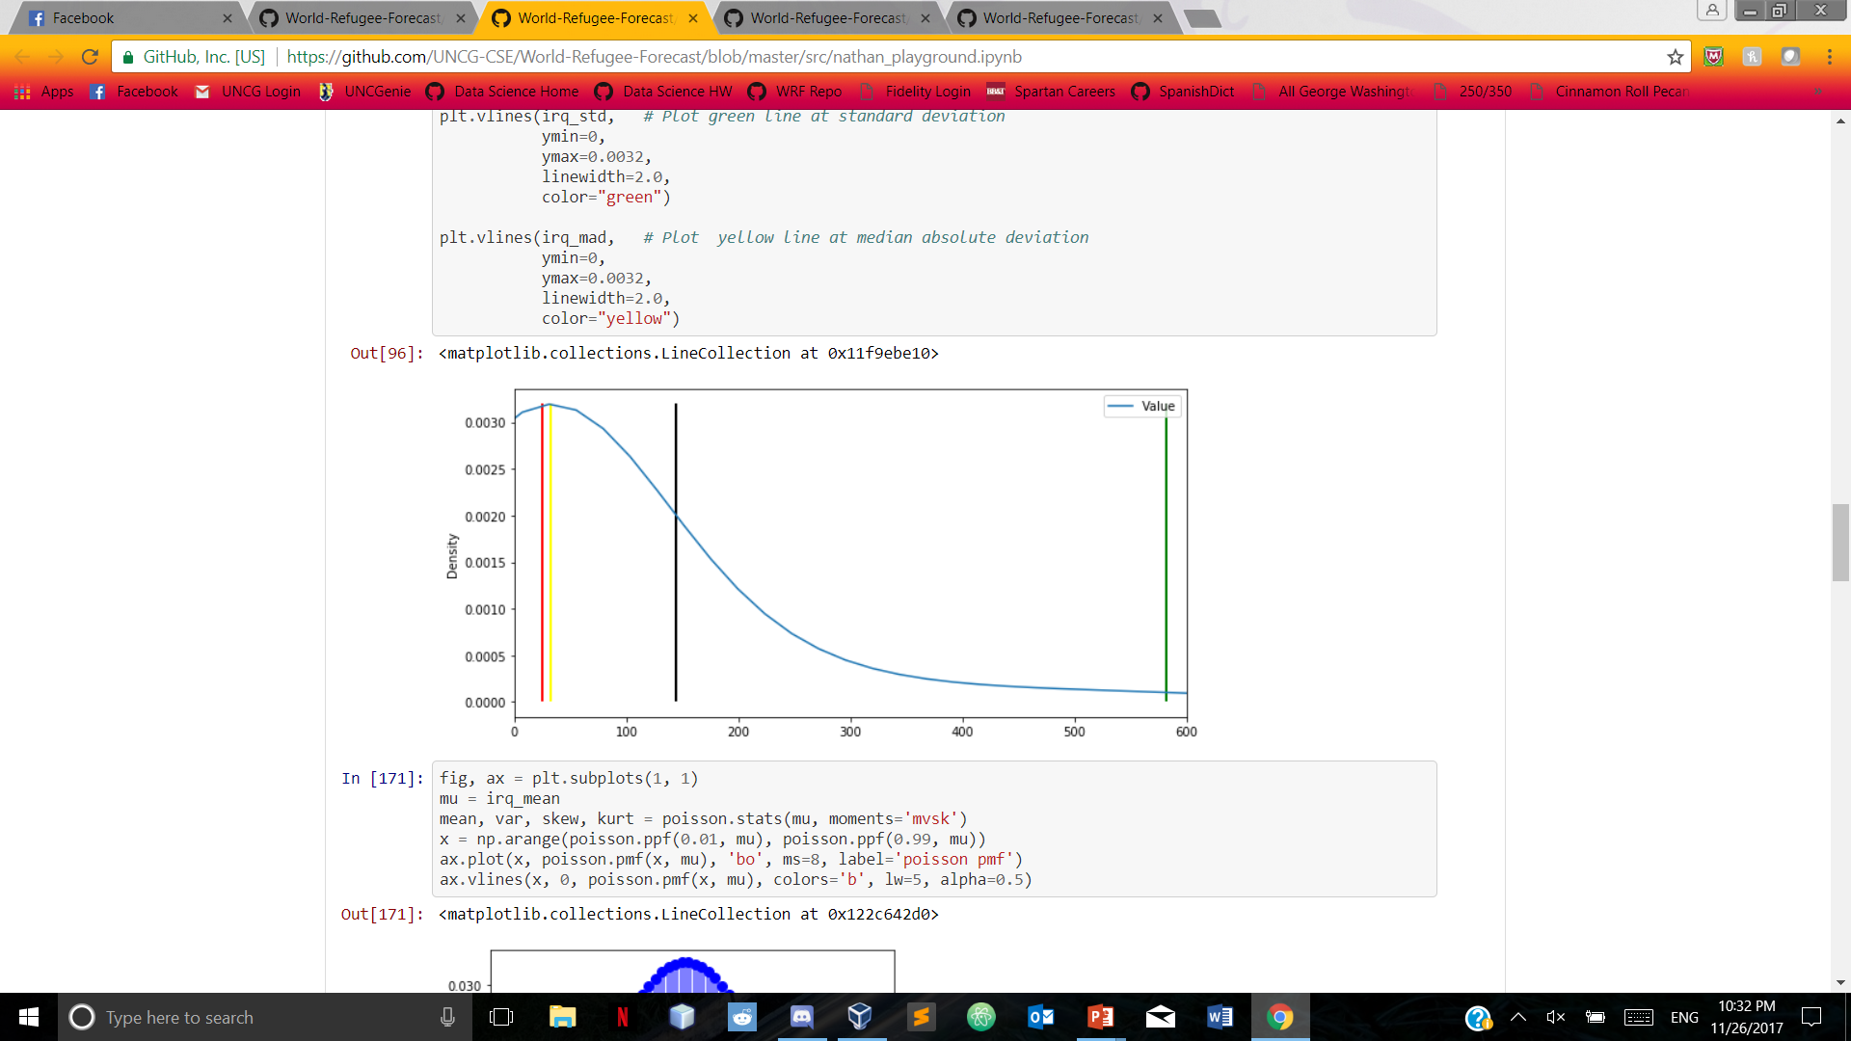
Divergence of mean Afghanistan iraq
Black line indicates mean, red line indicates median, green line indicates standard deviation, yellow line indicates median absolute deviation

Slide 12
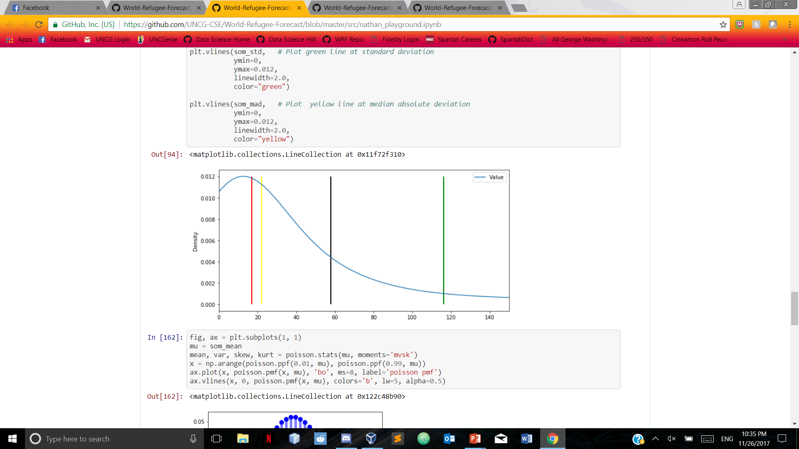
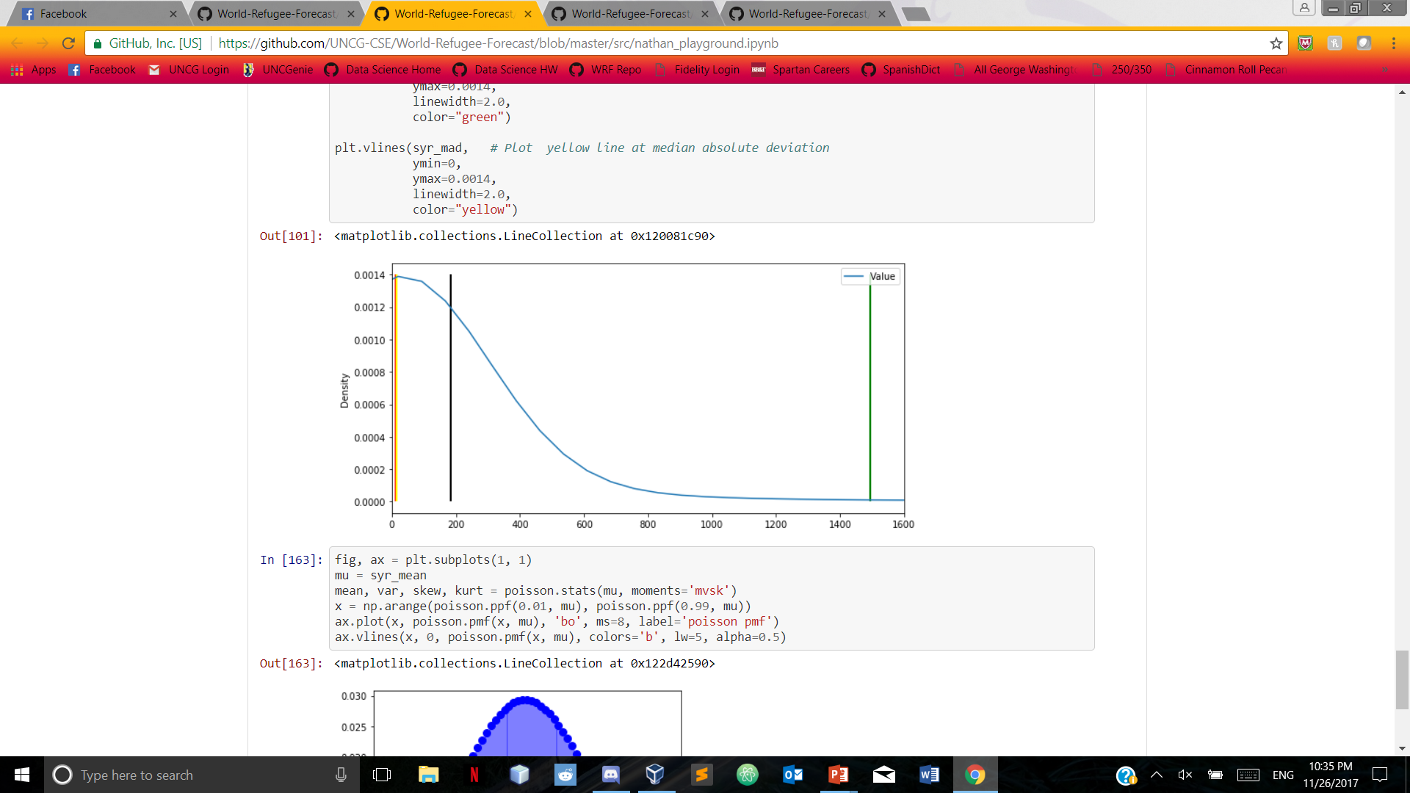
Divergence of mean Somalia syria
Black line indicates mean, red line indicates median, green line indicates standard deviation, yellow line indicates median absolute deviation

Slide 13
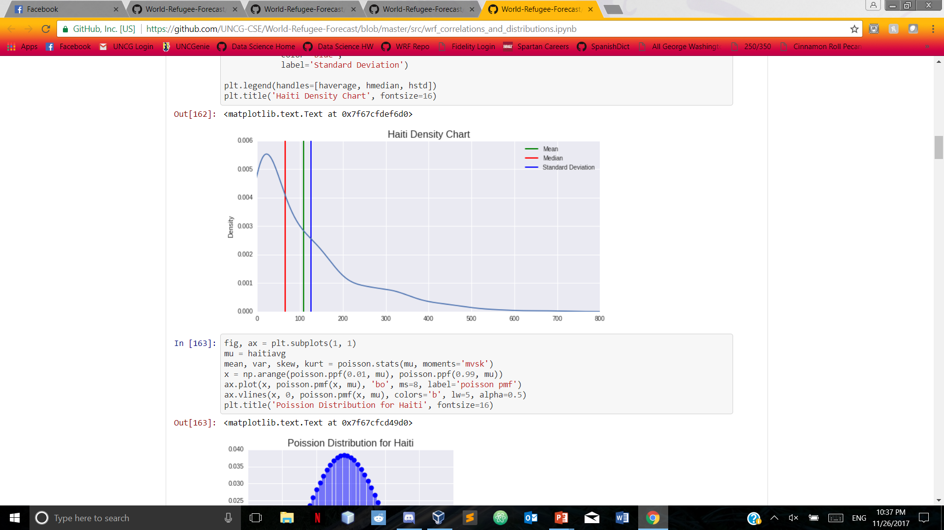
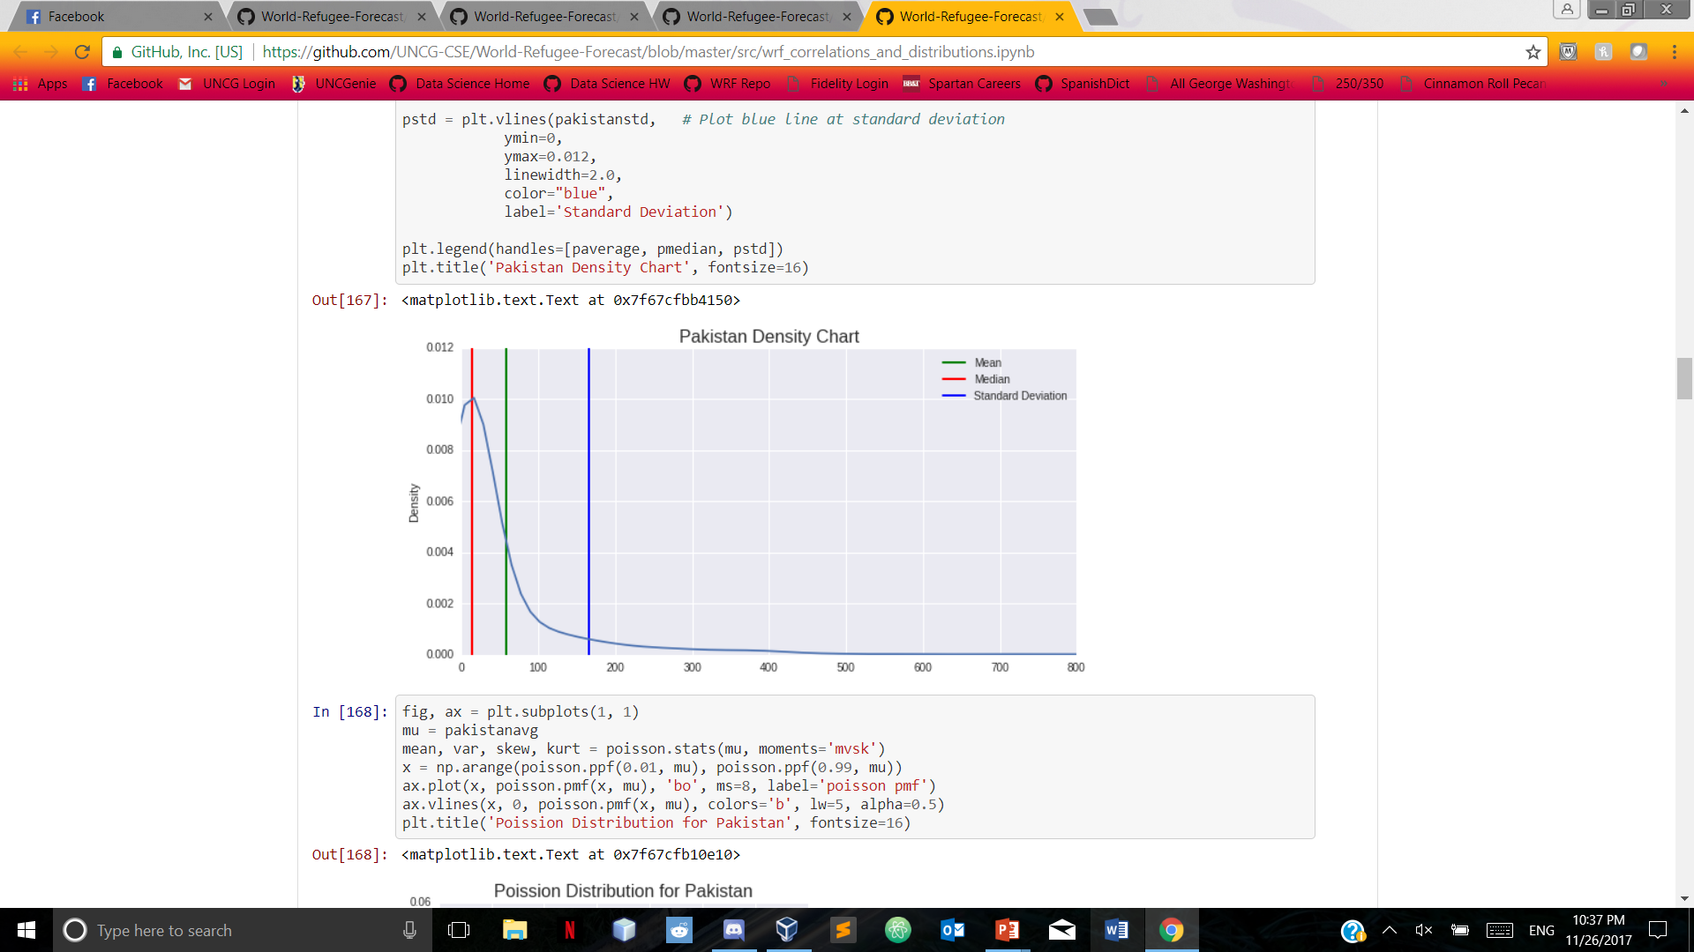


Slide 14
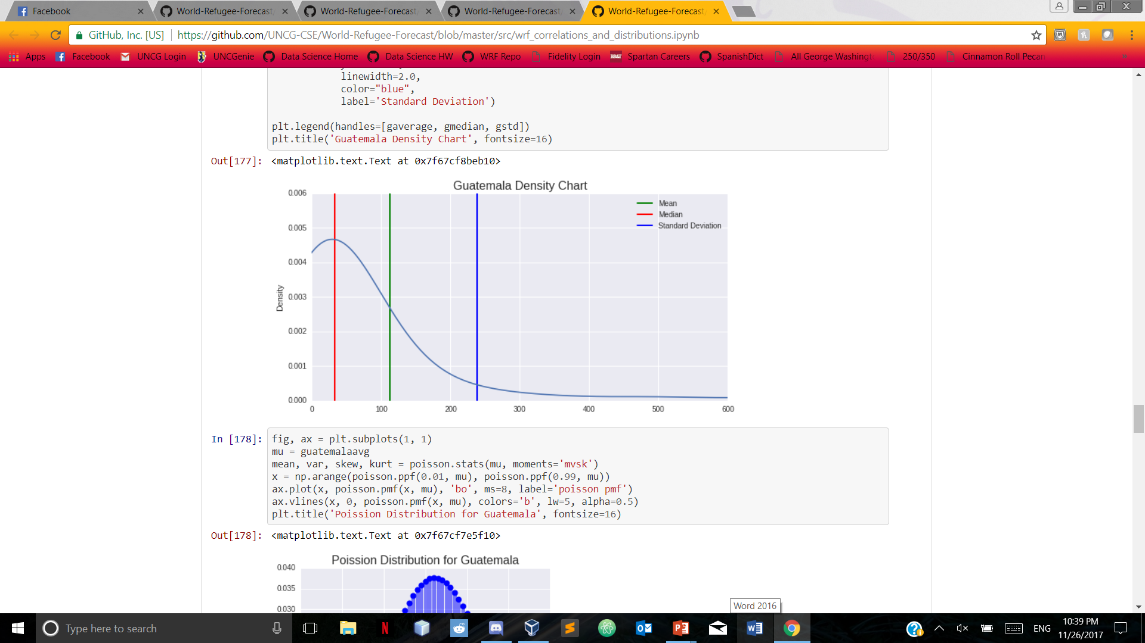
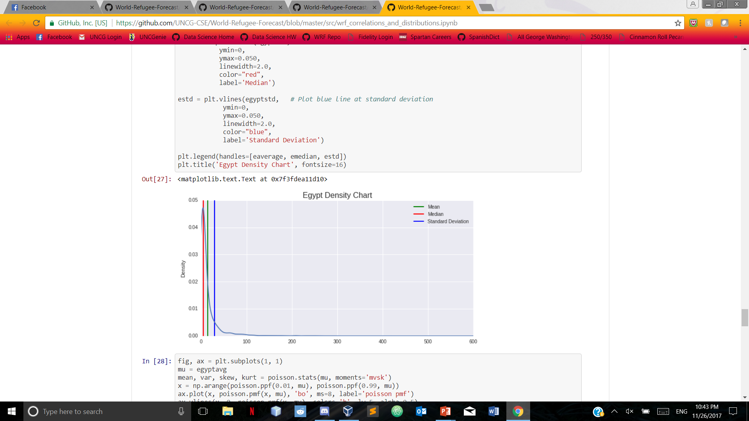

Slide 15
Linear regression
We picked a few countries to analyze using linear regression
Analyzed them alongside the food deficit data to determine if there was any relation to the food deficit and the number of people fleeing the country

Slide 16
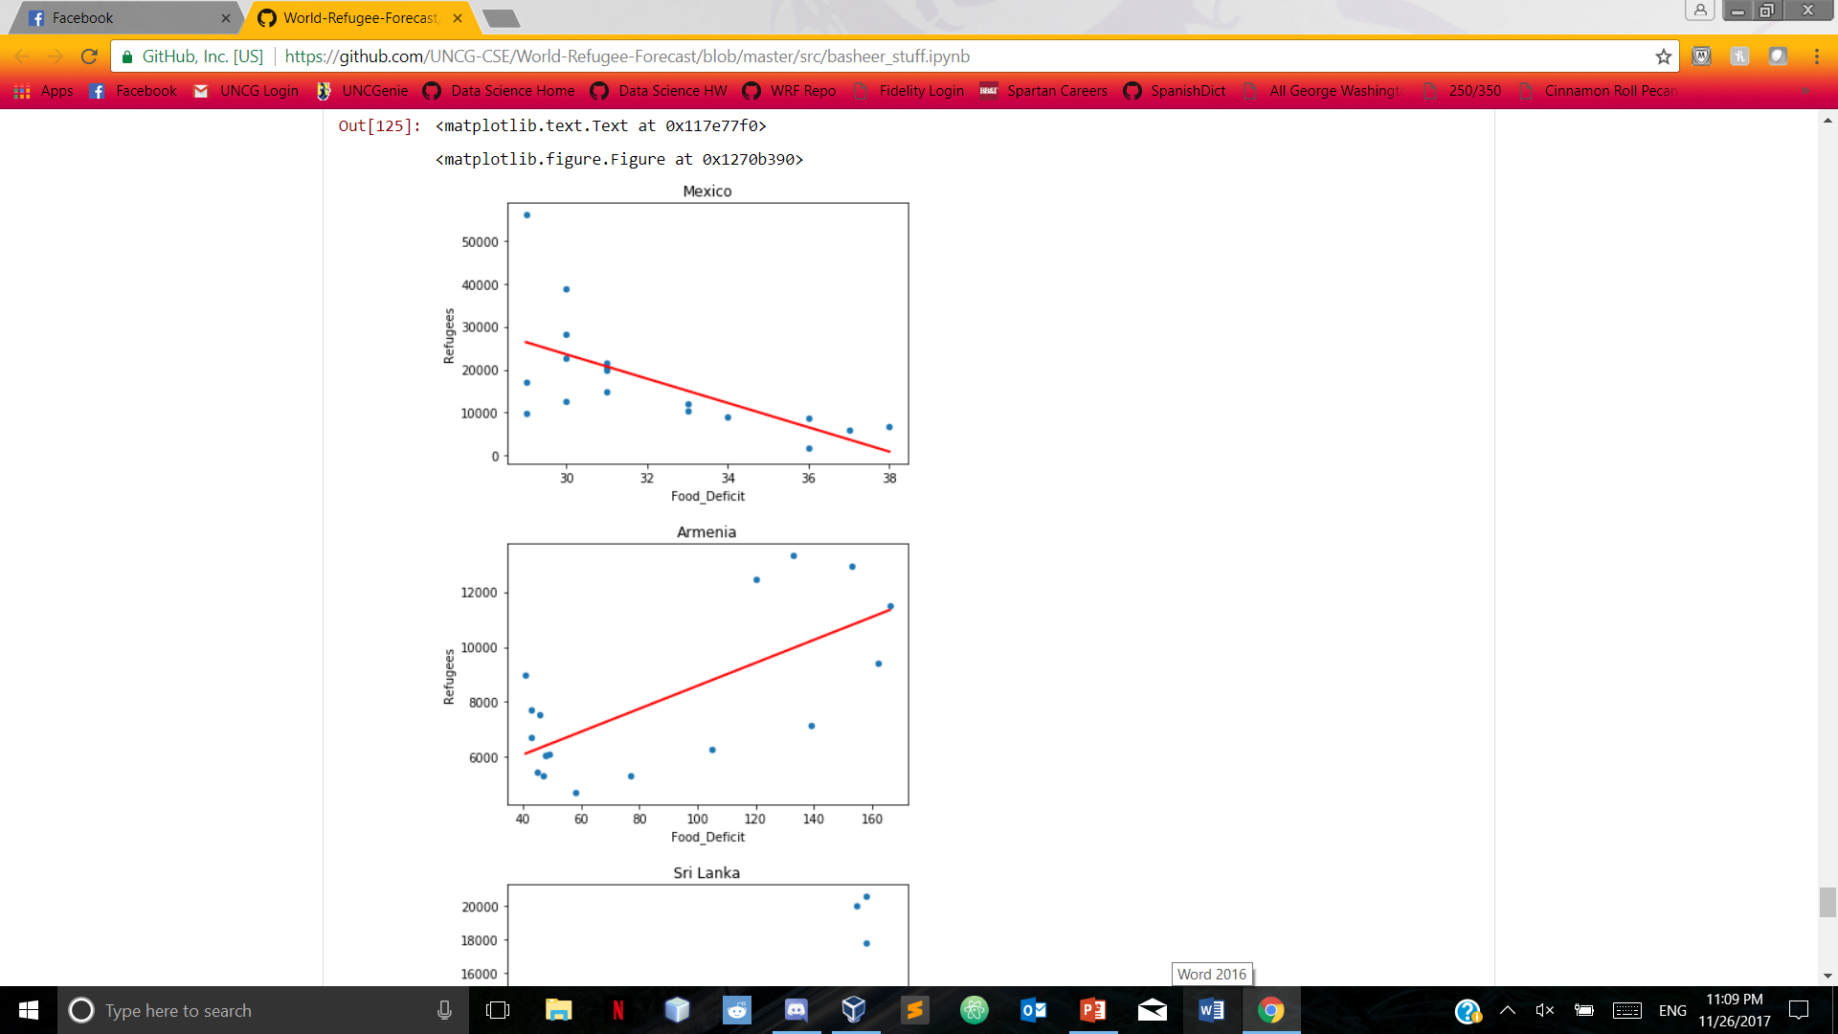
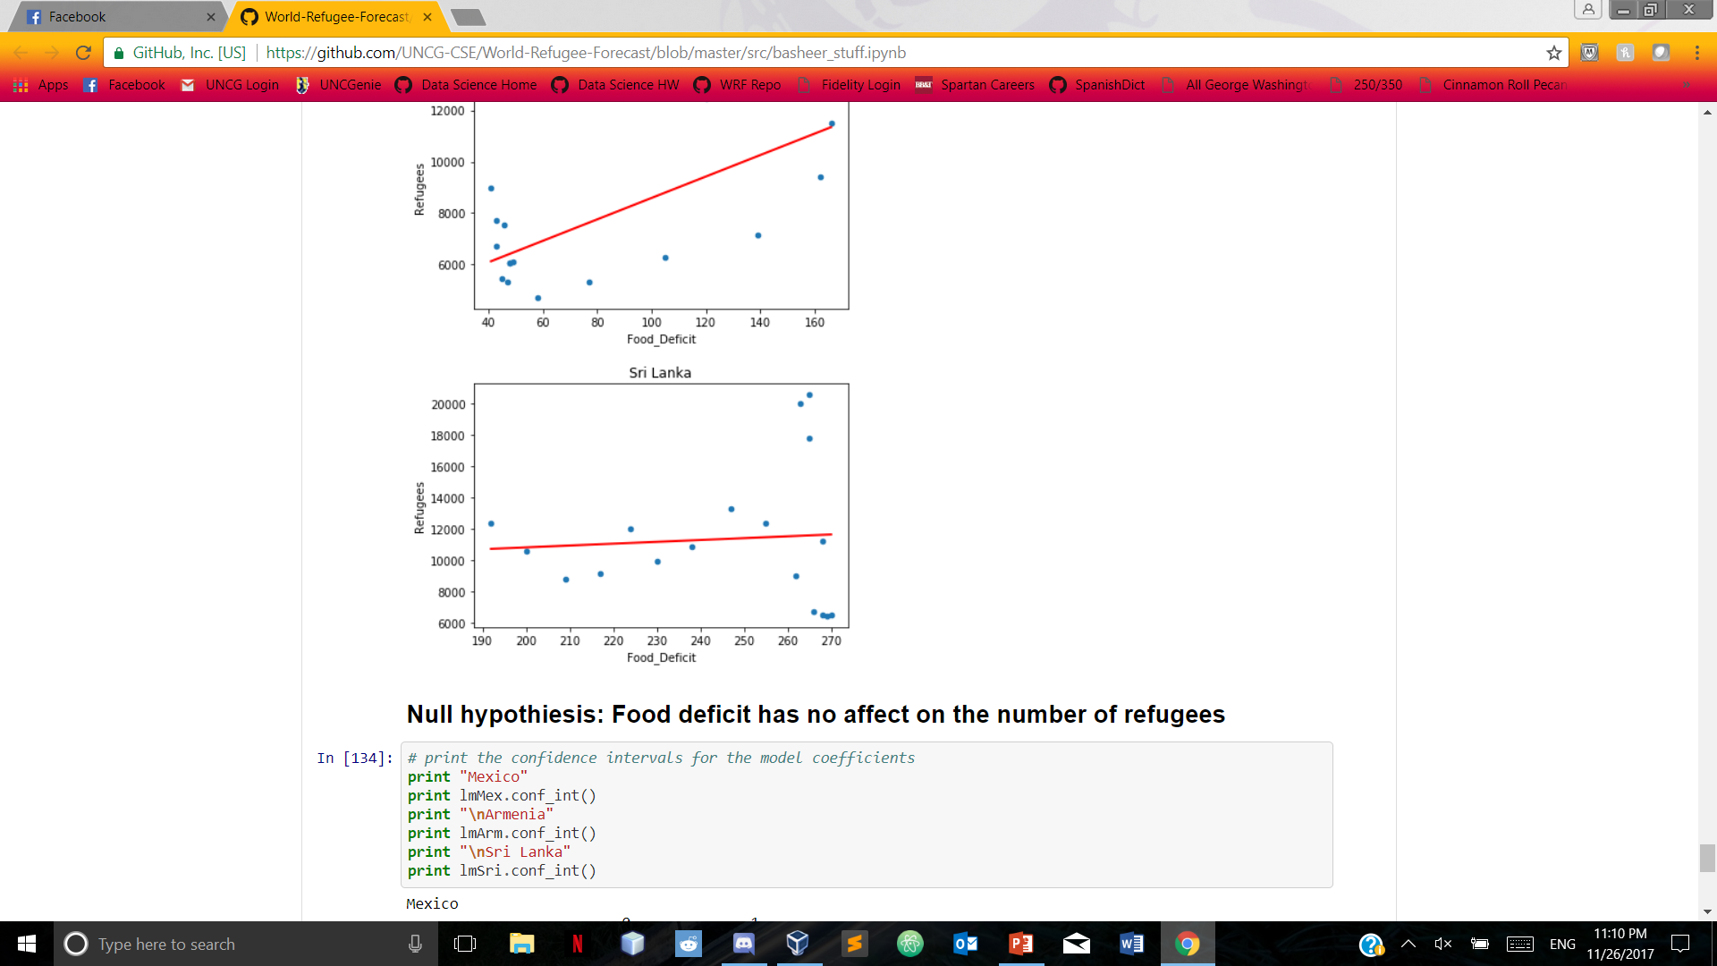
Linear regression: Mexico, Armenia, sri lanka

Slide 17
Machine Learning: SGD Classifier
SGD Classifier and Regression model in progress
SGD Classifier: takes a categorical variable (in our case, country) and allows it to be trained for predictions alongside other values (in our case, number of monthly refugees)
Used to predict where refugees will flee to based on country of origin and month
Work in progress
Works to where we can predict countries but no visualization yet

Slide 18
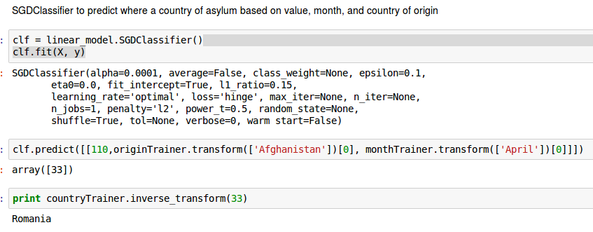
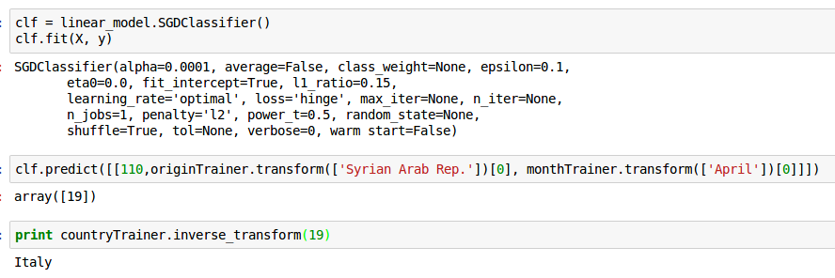
SGD Classifier (In Progress)

